Slide 1


Slide 2
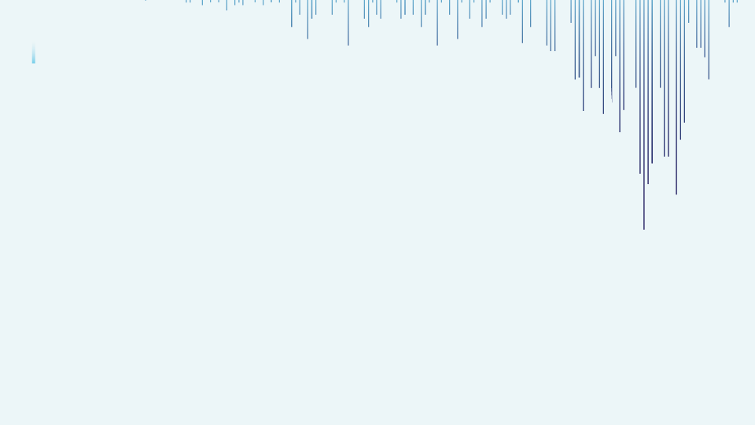

Topic- Classification
Prediction task is to determine whether a person makes over 50K a year. (We can explore the possibility in predicting income level based on the individual’s personal information. An individual’s annual income results from various factors. Intuitively, it is influenced by the individual’s education level, age, gender, occupation, and etc.).

Slide 3
Project Contents
Importing libraries
Loading and understanding the data​
EDA (Exploratory Data Analysis) and Preprocessing.
Train Test Split
Model building​
Logistic Regression
Decision Tree
Random forest ​
Support Vector Machine
K Nearest Neighbors
Extra Tree Classifier
Ada Boost Classifier
Gradient Boosting Classifier
XG Boost Classifier
Feature Importance​

Slide 4
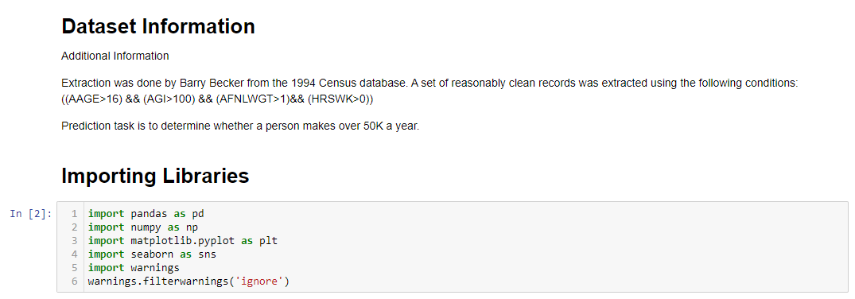
Importing Libraries, Loading & Understanding Data
We will be using the following libraries
Pandas
Numpy
Seaborn
Matplotlib.pyplot

Slide 5
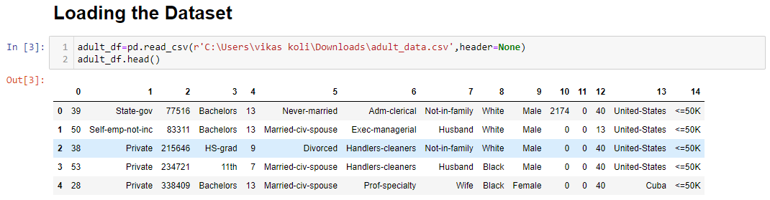

Slide 6
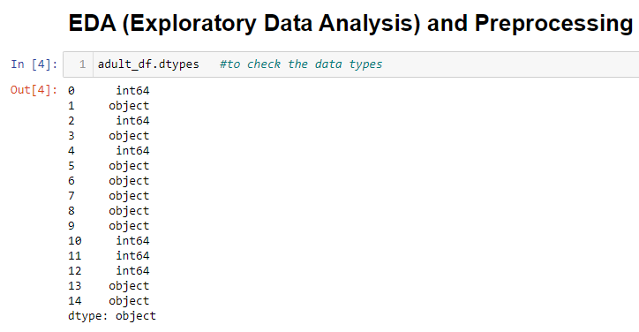
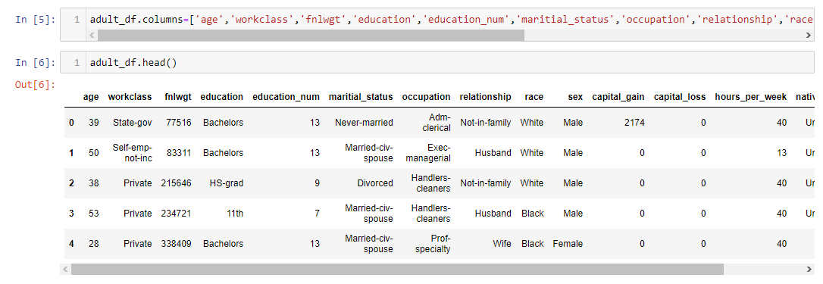

Slide 7
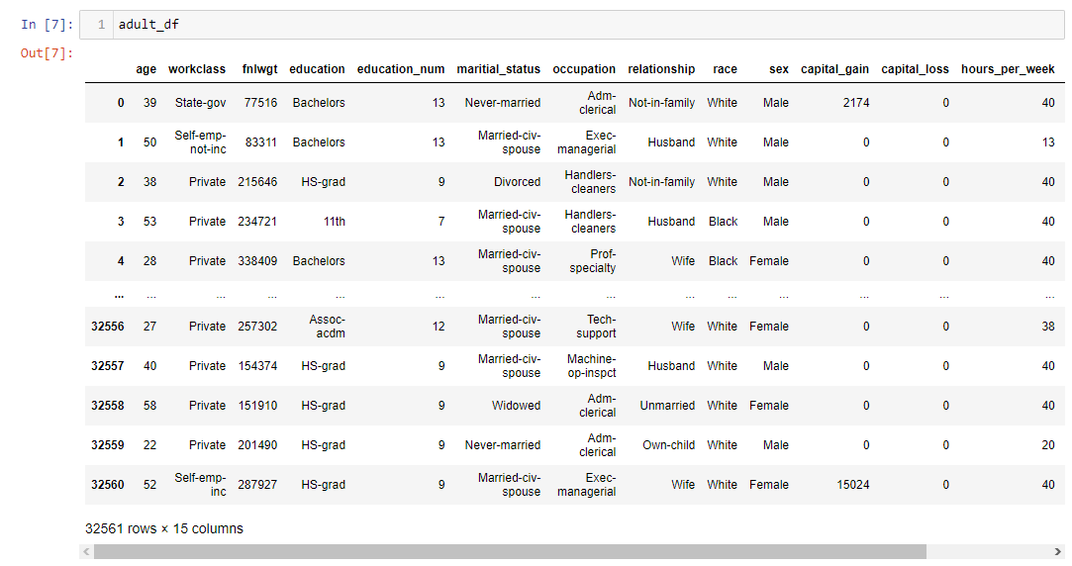
Dataset

Slide 8
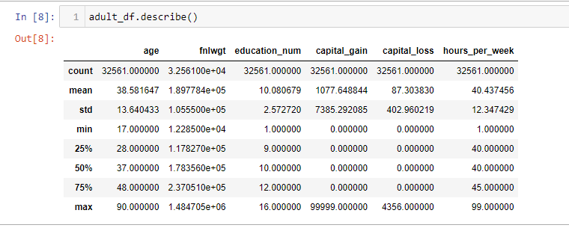
Exploratory Data Analysis & Pre-processing
Describe () –
The describe method returns the description of the data.

Slide 9
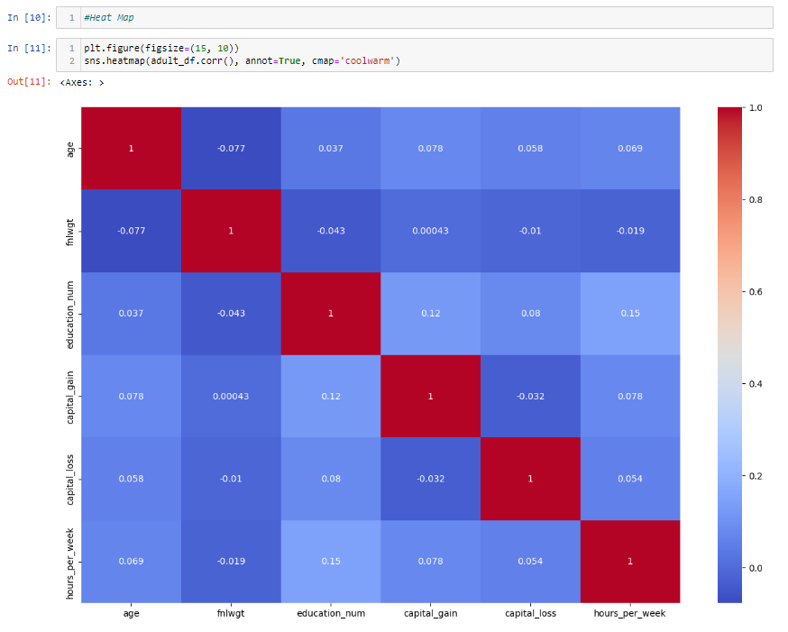
Correlation Heatmap
(To find which columns should be dropped)

Slide 10
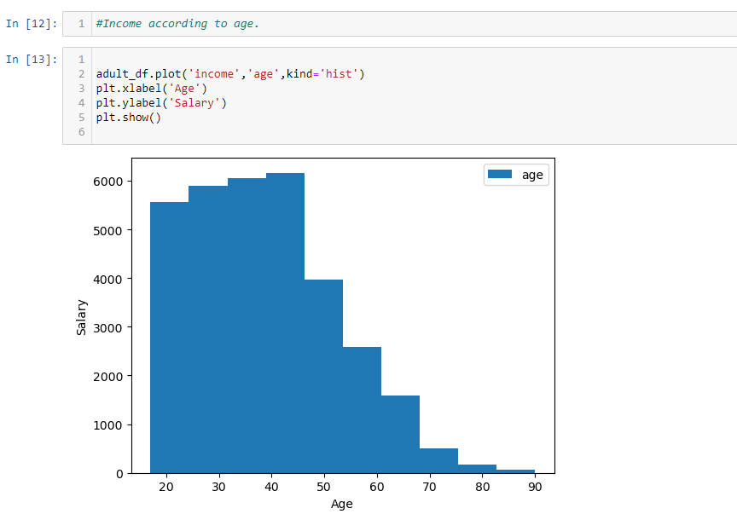

Slide 11
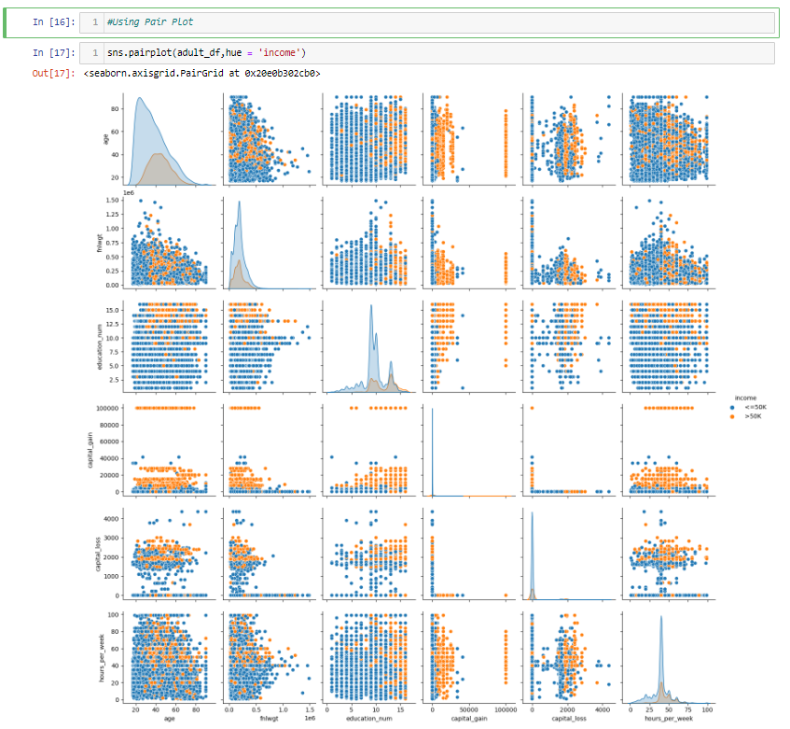

Slide 12
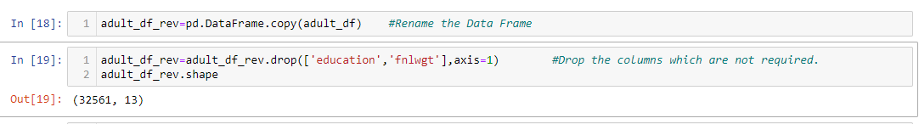
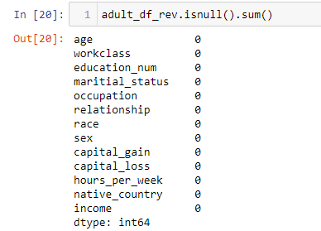
.is null()-
This method is applied to the Data Frame and returns a Data Frame of the same shape, where each cell contains a Boolean value (True or False). The Boolean value represents whether the corresponding cell in the original Data Frame is a missing (null) value (True) or not (False).

Slide 13
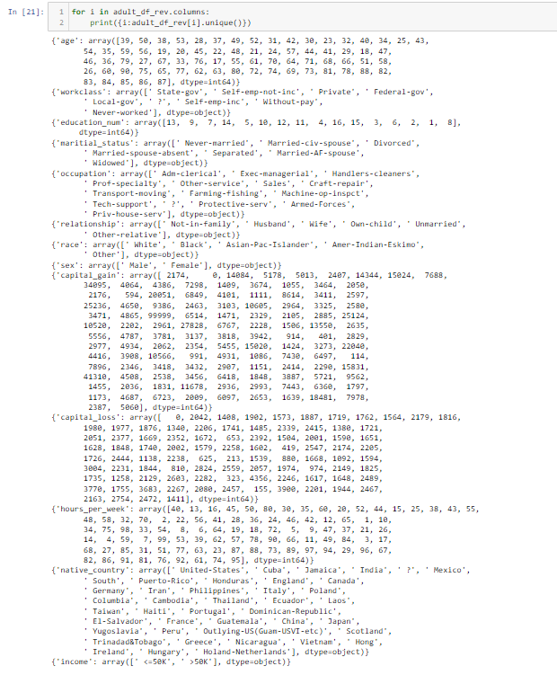
Unique Values:-
When you apply .unique to a data structure, it returns an array or a list containing only the unique values present in that data structure. In other words, it shows any duplicate values.

Slide 14
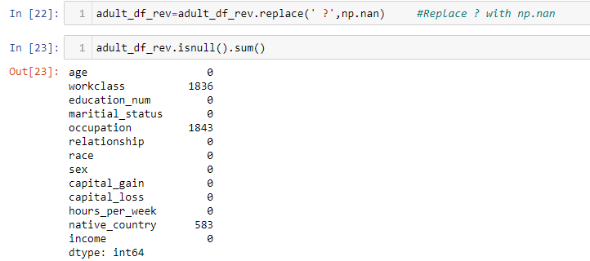
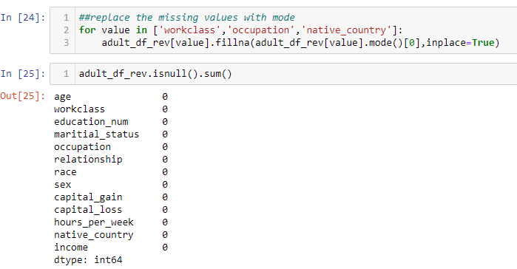
Replacing 'unknown' with mode values for each column because the data type is object

Slide 15
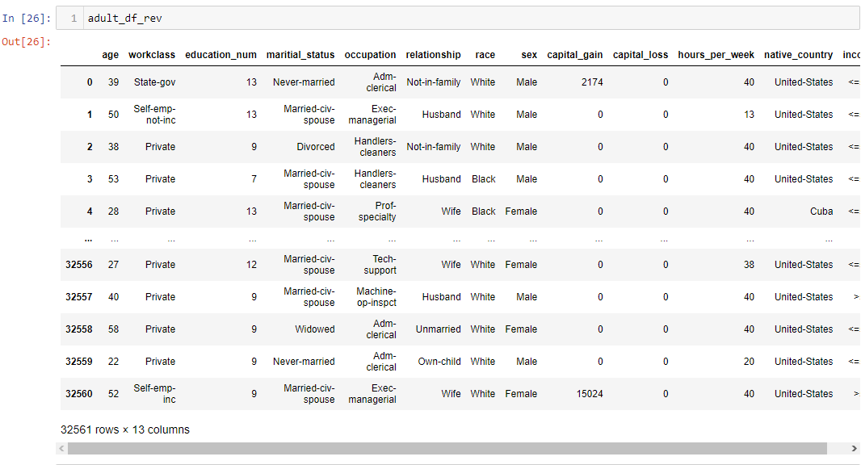

Slide 16
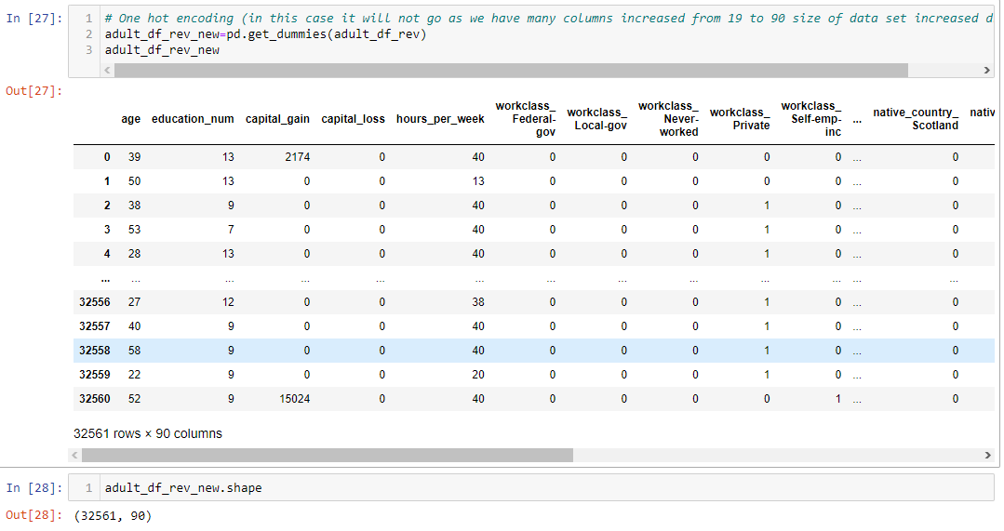
One hot encoding (in this case it will not go as we have many columns increased from 19 to 90 size of data set increased drastically)

Slide 17
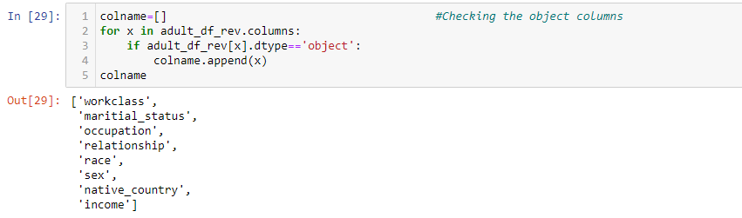
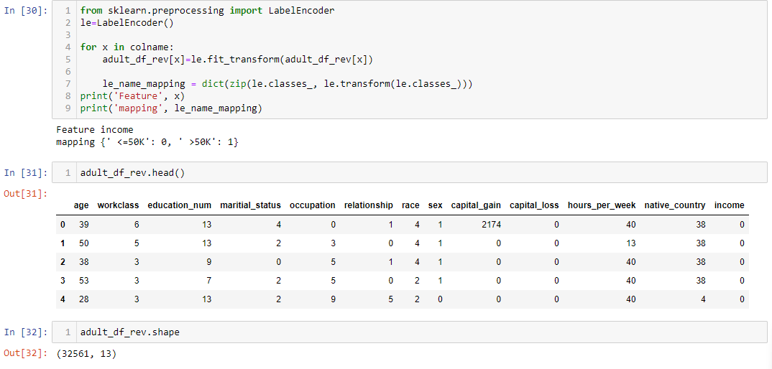
Using Label Encoding

Slide 18
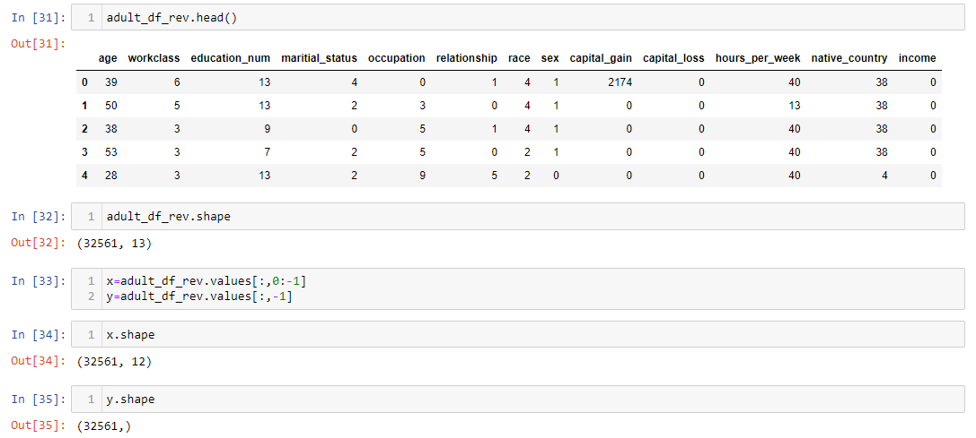
Shape after Label Encoding

Slide 19
Standardization
Standardization, also known as feature scaling or normalization, is a preprocessing technique commonly used in machine learning to bring all features or variables to a similar scale. This process helps algorithms perform better by ensuring that no single feature dominates the learning process due to its larger magnitude. Standardization is particularly important for algorithms that rely on distances or gradients, such as k-nearest neighbors, support vector machines, and gradient descent-based optimization algorithms.
The goal of standardization is to transform the features so that they have a mean of 0 and a standard deviation of 1. This transformation does not change the shape of the distribution of the data; it simply scales and shifts the data to make it more suitable for modeling.

Slide 20
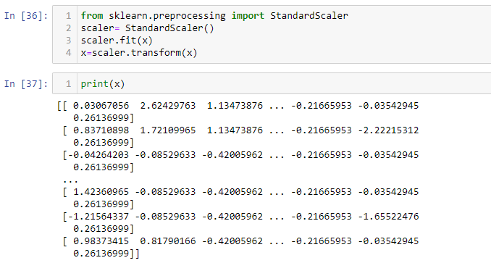
Standardization

Slide 21
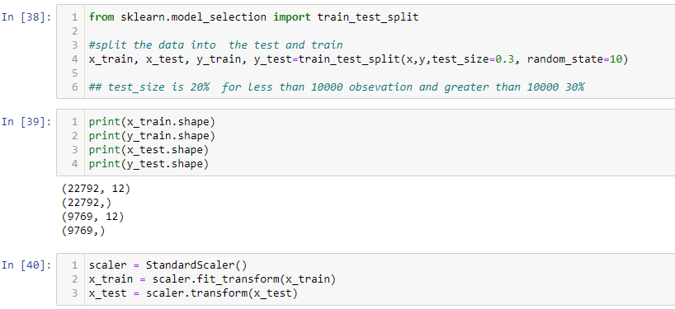
Splitting the Data Set

Slide 22
Model Building
Model Selection:
Choose an appropriate machine learning algorithm to identify whether a person makes over 50K a year. Some popular choices include Logistic Regression, Decision Tree, Random forest , Support Vector Machine, K Nearest Neighbors, Extra Tree Classifier, Ada Boost Classifier, Gradient Boosting Classifier, XG Boost Classifier.
Will now build the following models
Logistic Regression
Decision Tree
Random forest ​
Support Vector Machine
K Nearest Neighbors
Extra Tree Classifier
Ada Boost Classifier
Gradient Boosting Classifier
XG Boost Classifier
Importing the necessary module Splitting the dataset

Slide 23
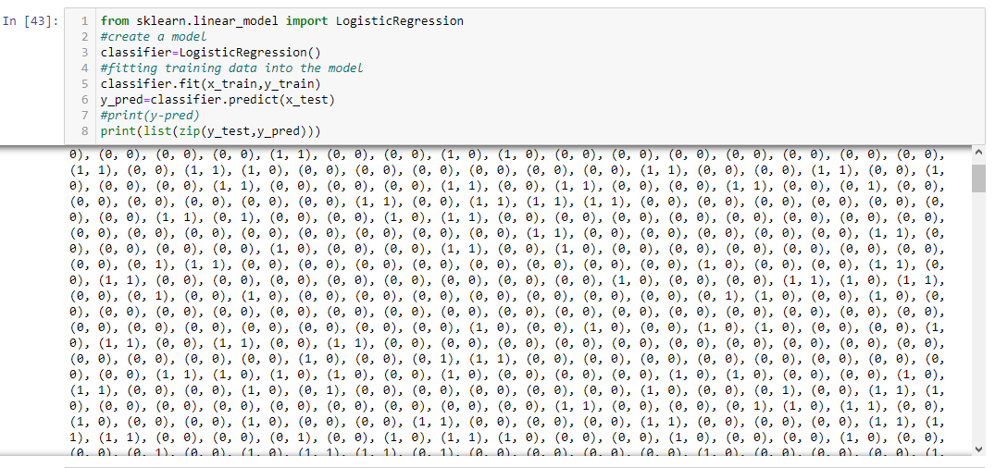
Logistic Regression
Logistic Regression is a fundamental algorithm in machine learning and statistics, primarily used for binary classification tasks. Despite its name, it is not used for regression problems; instead, it's a classification algorithm.
In many real-world scenarios, we encounter problems where we need to classify data points into one of two classes, such as spam or not spam, fraud or not fraud, cancerous or non-cancerous, etc. Logistic Regression is designed to handle such binary classification tasks.

Slide 24
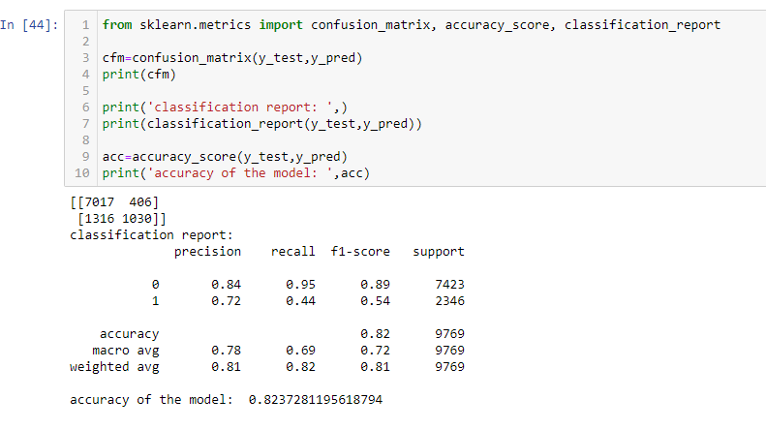
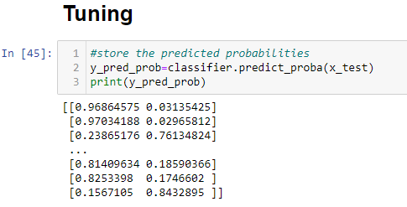

Slide 25
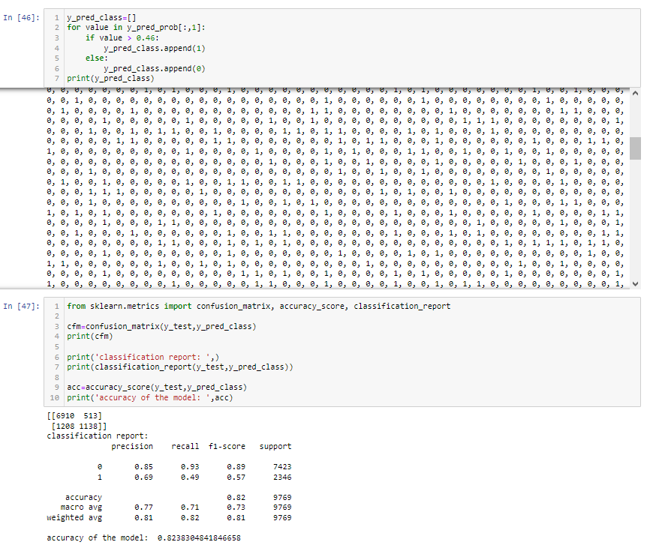
Understanding Probability Threshold:
In logistic regression, the model predicts the probability of an instance belonging to the positive class. By default, if the predicted probability is greater than or equal to 0.5, the instance is classified as positive; otherwise, it's classified as negative. This threshold of 0.5 is a common choice, but it might not be optimal for all scenarios.

Slide 26
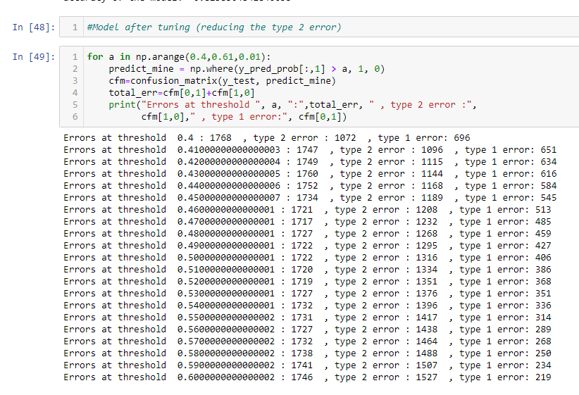
Adjusting the threshold•
Adjusting the threshold in logistic regression is a common technique used for tuning the model's performance, especially when dealing with imbalanced datasets or when you want to prioritize precision or recall based on your problem's requirements. Let's dive into how adjusting the threshold works and why it's important:

Slide 27
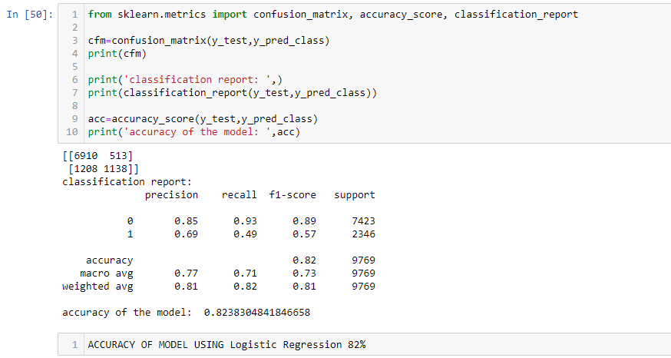
Accuracy Of Model Using Logistic Regression Is 82%

Slide 28
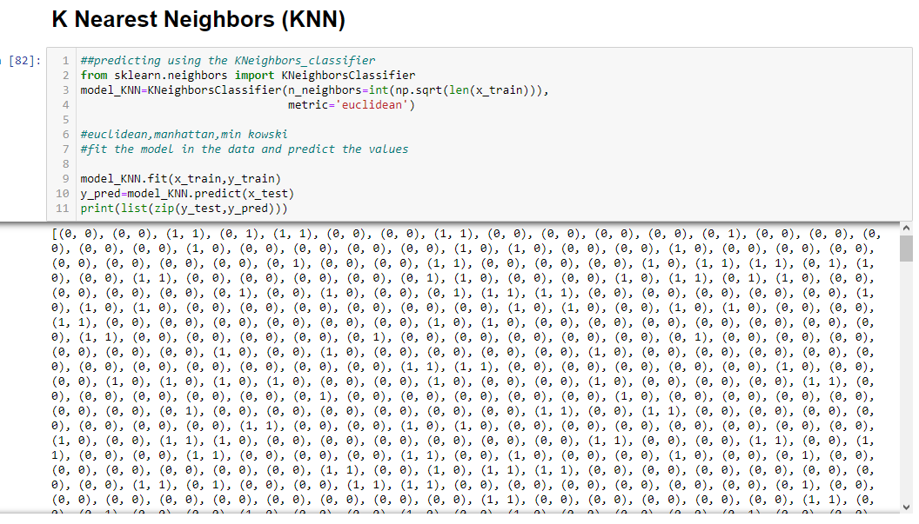

Slide 29
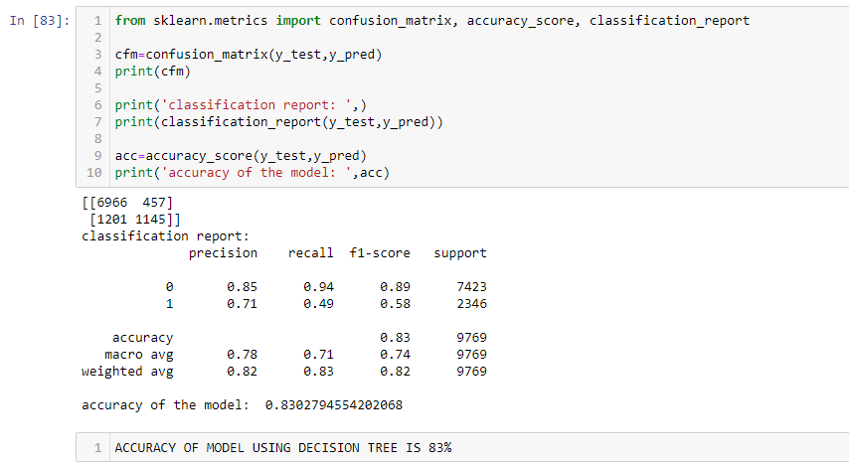
Accuracy Of Model Using KNN Model Is 83%

Slide 30
Decision Tree Algorithm
A decision tree algorithm is a supervised machine learning technique used for both classification and regression tasks. It works on checking up the impurities based on Gini Index and Entropy which can be applied to a wide range of problems.

Slide 31
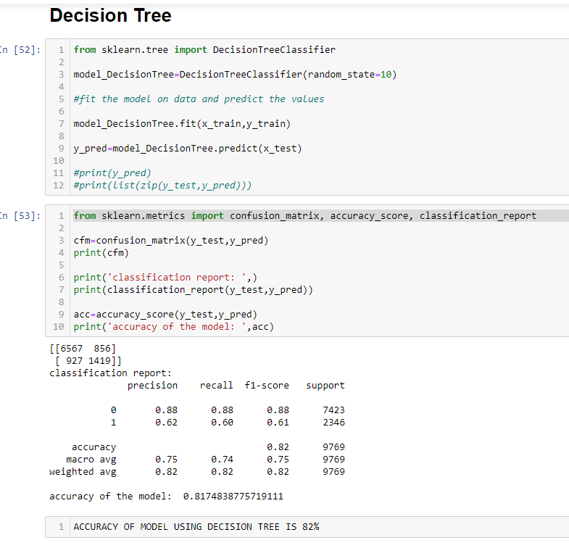
Accuracy Of Model Using Decision Tree is 82%

Slide 32
Random Forest
Random Forest is a powerful ensemble learning algorithm used for classification and regression tasks. It's based on the concept of decision trees and combines multiple decision trees to make more accurate predictions.

Slide 33
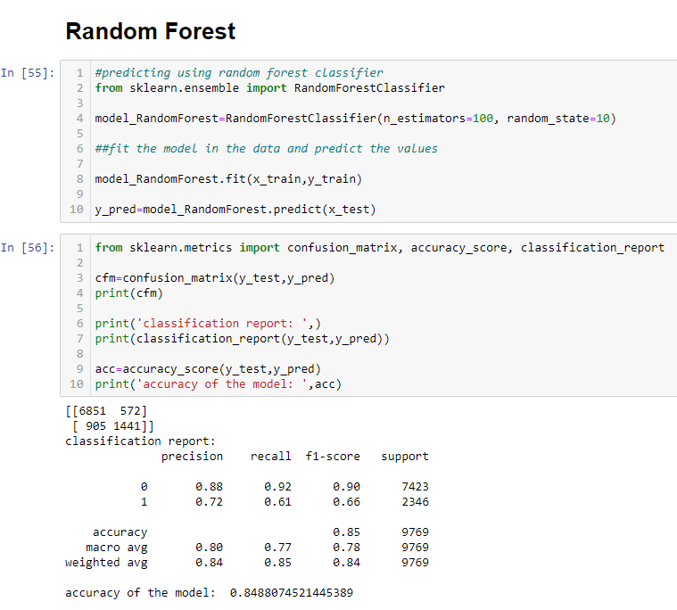
Accuracy of Model Using Random Forest is 85%

Slide 34
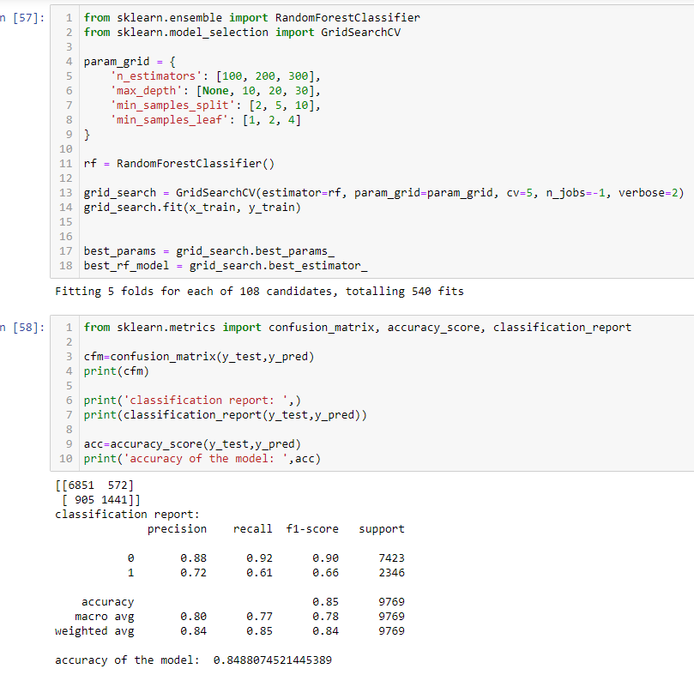
Accuracy of Model Using Random Forest GridSearch is 85%

Slide 35
Support Vector Machine
Support vector machine is a supervised machine learning algorithm in which we have labelled data i.e. both X and Y are given.
It is used for both classification and regression problem.
It is mostly used for high dimensional data set(No. of variables is more)
SVM allows as to convert N dimensional data set into a well defined hyperplane(Mostly by squaring the co-ordinates)
It converts non-linearly separable data to linear data

Slide 36
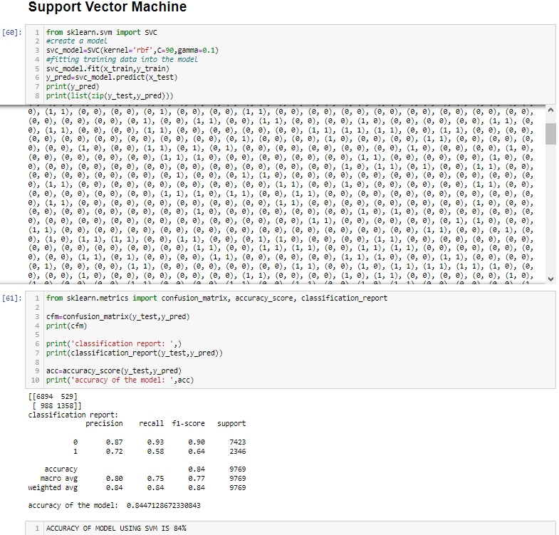
Accuracy Of Model Using SVM Is 84%

Slide 37
Extra Trees Classifier
The Extra Trees Classifier is a powerful ensemble learning method that harnesses the collective wisdom of numerous unpruned decision trees, which together form a "forest." This ensemble technique then combines the individual tree predictions using majority voting to provide a final classification result. This approach enhances accuracy and robustness in classification tasks by leveraging the diverse insights of its constituent trees.

Slide 38
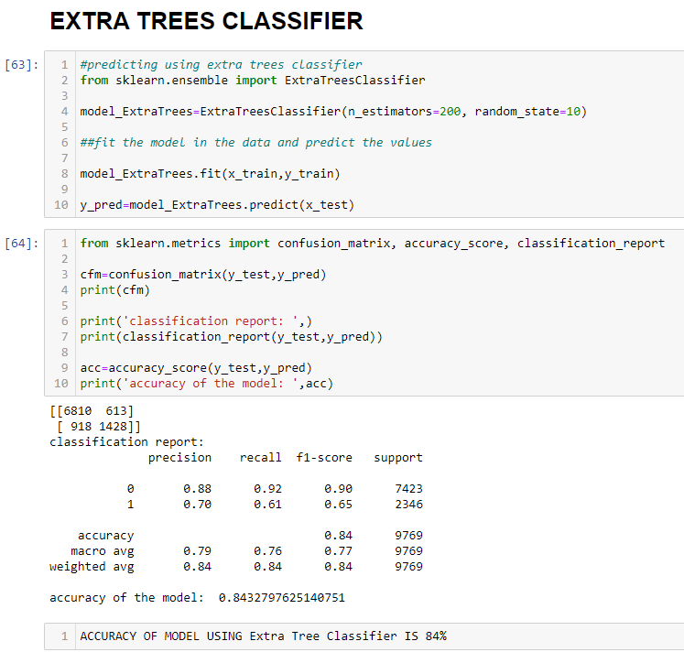
Accuracy of Model Using EXTRA TREE CLASSIFIER is 84%

Slide 39
AdaBoost Classifier
AdaBoost is a supervised learning algorithm that can be used in a wide variety of classification and regression tasks. It begins by fitting a classifier on the original dataset and then fits additional copies of the classifier on the same dataset. Each individual model in the ensemble votes on an example based on whether it lies above or below the model's threshold for its feature.

Slide 40
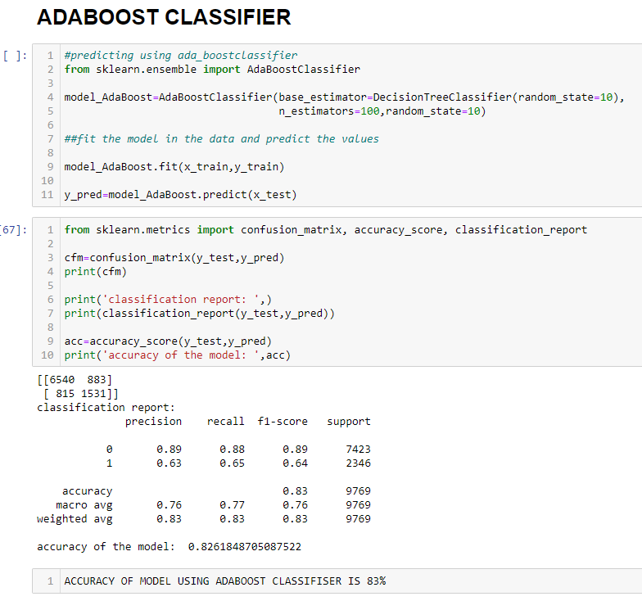
Accuracy of Model using ADABOOST CLASSIFIER is 83%

Slide 41
Gradient Boosting Classifier
Gradient Boosting builds an ensemble of decision trees sequentially, where each tree tries to correct the mistakes of the previous ones. It's powerful and often yields strong predictive performance

Slide 42
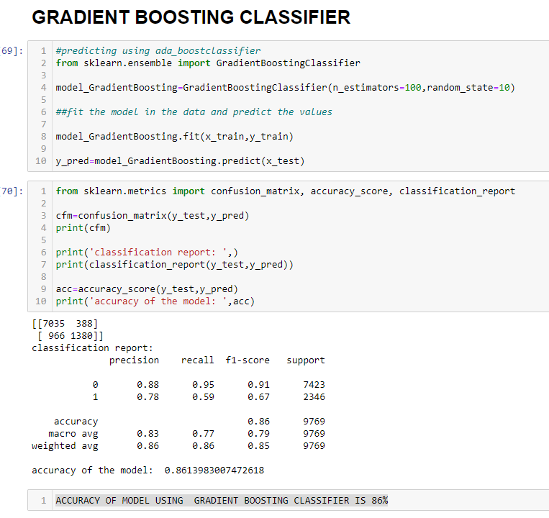
Accuracy of Model using GRADIENT BOOSTING CLASSIFIER is 86%

Slide 43
XGBoost Classifier
XGBoost stands for Extreme Gradient Boosting. It's a decision-tree-based ensemble algorithm that uses a gradient boosting framework. XGBoost uses advanced regularization (L1 & L2), which improves model generalization capabilities. It's training is very fast and can be parallelized across clusters. It can be used to solve classification and regression problems. It's designed for problems where you have training data that can be used to create a classifier, and then you have new data that you want to classify.
XGBoost can be used in:
Regression
Binary classification
Multi-class classification (One-vs-all)
XGBoost is a more regularized form of Gradient Boosting. It delivers high performance as compared to Gradient Boosting.

Slide 44
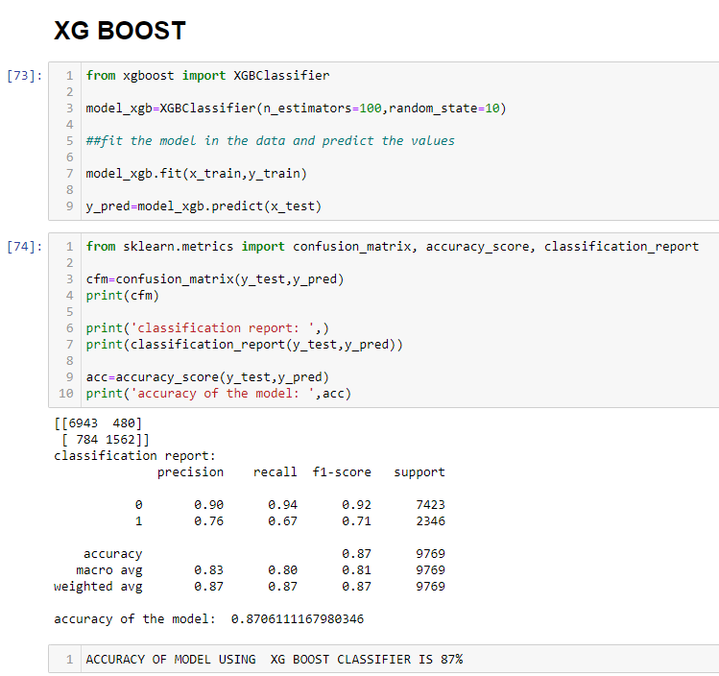
Accuracy of Model using XG Boost CLASSIFIER is 87%

Slide 45
Interpretation of the confusion matrix for XGBoost Model
Classification Report:
True Negative (TN): 6943
False Positive (FP): 480
False Negative (FN): 784
True Positive (TP): 1562

Slide 46
Classification Report for XGBoost Model
-
Precision (for Class 1, positive class): 0.76
This means that out of all the instances predicted as positive, 76% of them are truly positive. It indicates the model's ability to make accurate positive predictions.
Recall (for Class 1, positive class): 0.67
This means that the model correctly identifies 67% of all the actual positive instances. It's a measure of the model's ability to capture positive cases.
F1-Score (for Class 1, positive class):0.71
The F1-score is the harmonic mean of precision and recall. It provides a balance between precision and recall. In this case, the F1-score for Class 1 is 0.71, indicating a reasonable balance between precision and recall.
Accuracy: 0.87
The overall accuracy of the model is 87%, which is the percentage of correctly classified instances out of all instances. It suggests that the model performs well in terms of overall accuracy.
Interpretation:
The F1-score of 0.71 is a balance between precision and recall. It indicates that the model provides a reasonable trade-off between making accurate positive predictions and capturing actual positive instances.
The overall accuracy of 87% suggests that the model performs well in terms of overall correctness

Slide 47
Conclusion
All the models mentioned above achieved impressive accuracy, however XGBoost Classifier, an advanced ensemble machine learning algorithm, standing out by delivering the highest accuracy of 87% while also demonstrating the lowest type two error. This achievement is further supported by notable precision (0.76), recall (0.67), and F1-score (0.71) for Class 1 (the positive class).
The overall accuracy of 87% reflects the model's strong overall performance in terms of correctness. Taking all aspects into account, it's evident that the XGBoost Classifier Algorithm outperforms the others across the board, making it the preferred choice for this task. Therefore, we will proceed with the utilization of the XGBoost Classifier Model.

Slide 48

Thank you!!!

